Slide 1
ML Frameworks and Optimised Libraries (Chapter 3)
Oliver Grainge

Slide 2
Learning Outcomes
Cost & Energy Efficiency with CPUs:
Understand how leveraging CPUs reduces capital/operational expenses.
Challenges of Increasing Model Complexity:
Identify the impact of growing compute requirements, memory bandwidth limits, and latency constraints.
Graph-Based Computation:
Explain how computation graphs Directed Acyclic Graphs (DAGs) model operations and data flow.
Execution Modes & Compilation Techniques:
Differentiate between graph mode (static/compiled) and eager mode (dynamic) execution.
Framework Ecosystem:
A variety of frameworks and libraries (e.g., PyTorch, Arm Compute Library, Llama.cpp) support these optimizations, catering to diverse deployment scenarios—from cloud to edge.
Notes:
CPUs offer cost-effective and energy-efficient inference, reducing both capital and operational expenses.
Increasing AI model complexity brings new challenges, such as compute demands and memory bandwidth limitations.
Computation graphs (DAGs) provide a structured way to model operations and optimize data flow.
Understanding execution modes helps differentiate between static graph execution and dynamic (eager) execution.
Frameworks like PyTorch and Arm Compute Library provide tools to optimize inference across cloud and edge devices.

Slide 3
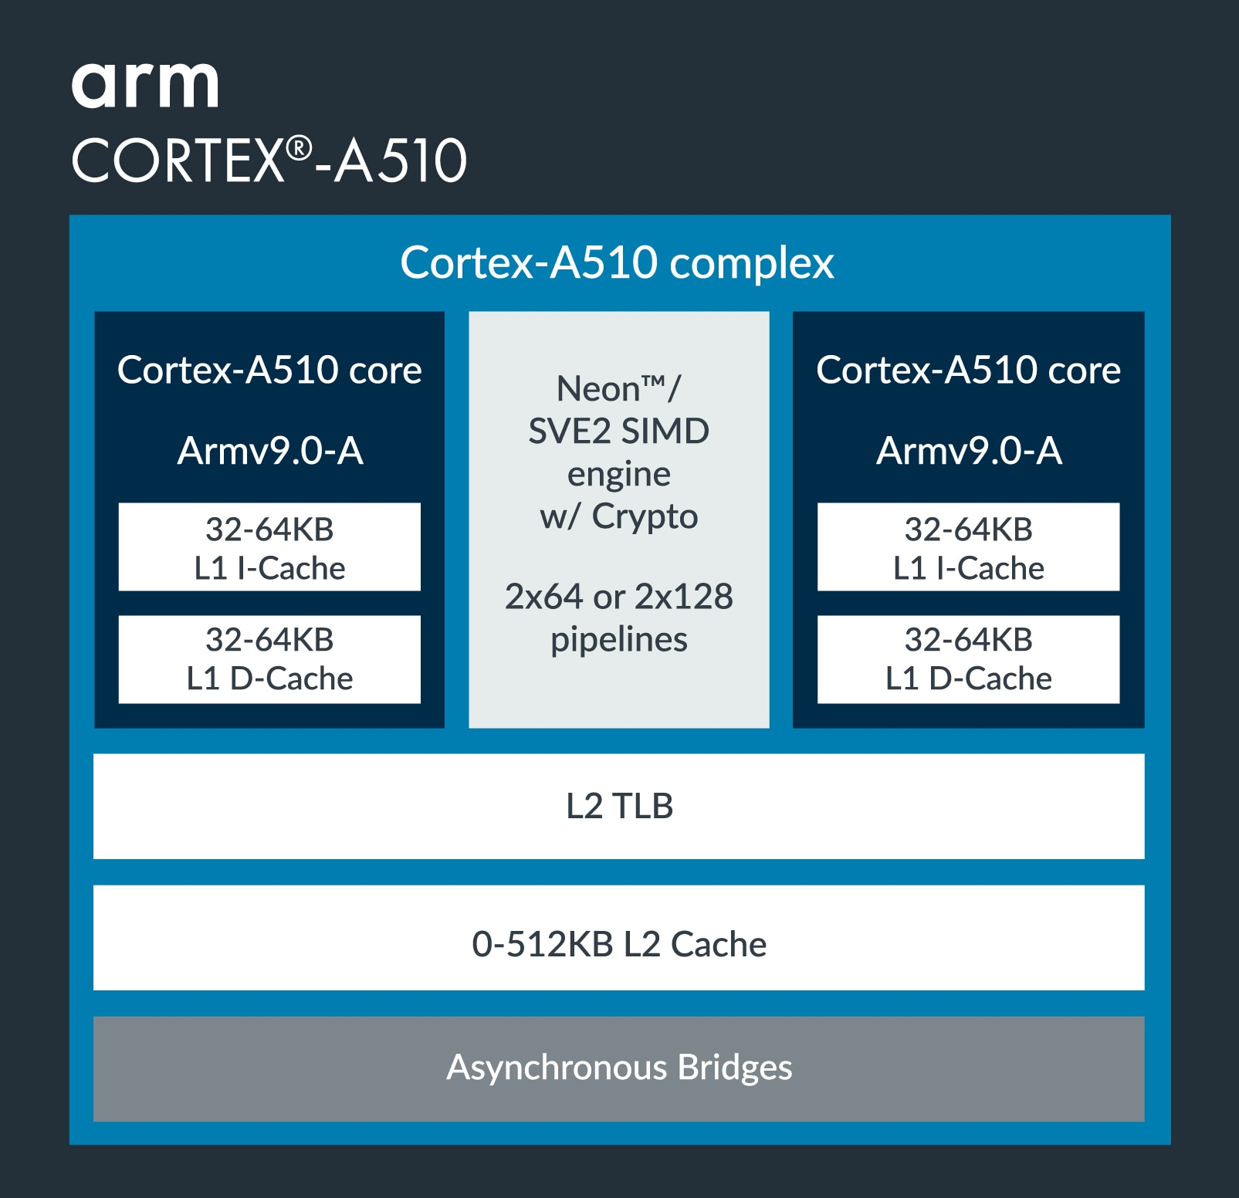
Why Optimize for CPU Inference?
Cost Efficiency:
Leverage existing CPUs to lower capital and operational expenses versus investing in specialized GPUs.
Ubiquity:
CPUs power most edge devices and servers, ensuring broad compatibility and seamless integration.
Energy Efficiency & Latency:
Tailored optimizations (e.g., vectorized operations) reduce energy consumption and deliver fast, real-time responses.
Data Security:
Local inference minimizes data transmission, enhancing privacy and simplifying compliance with regulations.
Notes:
CPUs provide a cost-effective alternative to specialized GPUs, leveraging existing hardware to minimize additional investment.
Their ubiquity across edge devices and servers ensures broad compatibility and seamless deployment.
Optimizations such as vectorized operations improve energy efficiency and enable low-latency inference.
Running inference locally on CPUs enhances data security by reducing data transmission and ensuring compliance with privacy regulations.

Slide 4
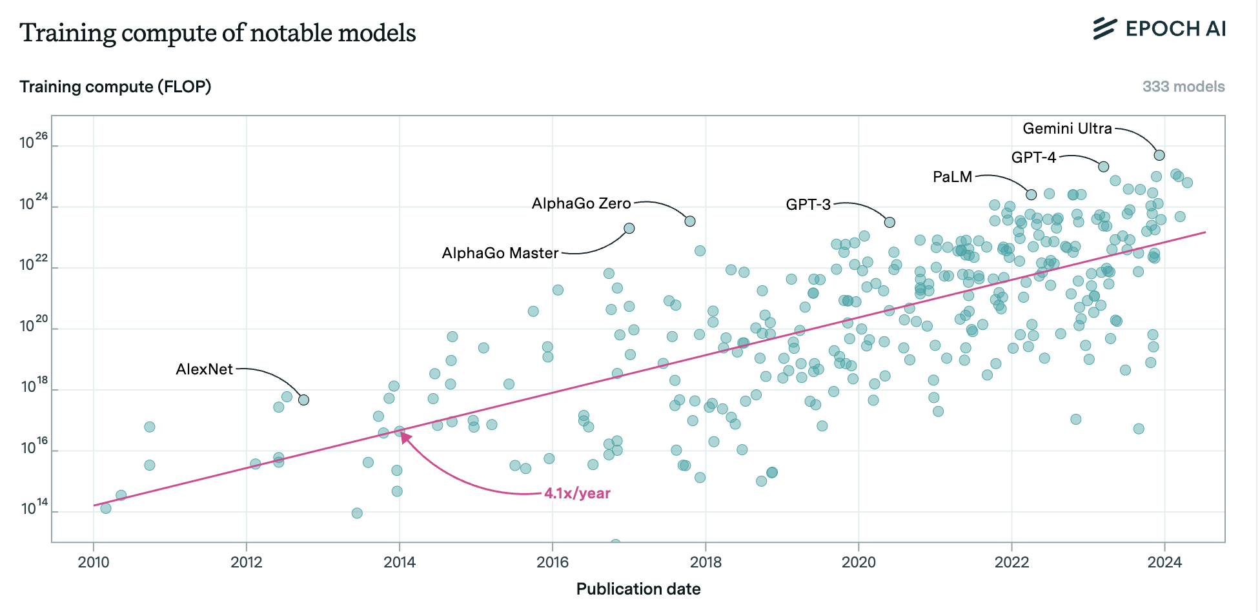
Revisiting CPU Inference Challenges
Increasing Model Complexity:
Generative AI Model compute requirements are growing 4-5x per Year.
Memory & Data Throughput Bottlenecks:
Large models demand high memory bandwidth and efficient data movement, which can stress CPU memory hierarchies.
Scalability:
The heavy computational load of generative AI challenges multi-threaded processing and optimal core utilization on CPUs.
Stringent Low-Latency Demands:
Real-time inference applications require minimal latency, posing difficulties for traditional CPU setups under high workloads.
Jaime Sevilla and Edu Roldán (2024), "Training Compute of Frontier AI Models Grows by 4-5x per Year". Published online at epoch.ai.
Notes:
AI model complexity is increasing rapidly, with compute requirements growing 4-5x per year.
Large models require high memory bandwidth and efficient data movement, which can create bottlenecks.
Scalability is a concern, as generative AI workloads require efficient multi-threading and core utilization.
Low-latency applications pose a challenge for CPUs under high computational loads, requiring optimized execution strategies.

Slide 5
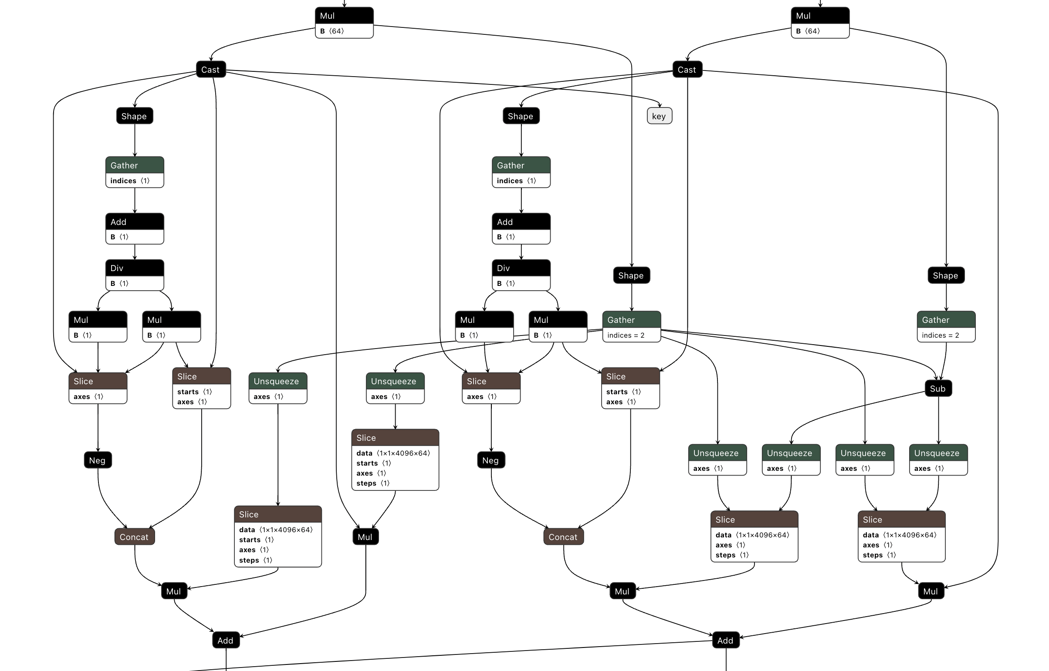
Generative AI Model as a Graph
Graph Structure:
Nodes: Represent operations (e.g., layers, activations, transformations) within the model.
Edges: Depict data flow and dependencies between operations.
Directed Acyclic Graph (DAG):
Ensures a clear, sequential execution order from input to output without circular dependencies.
Visualization & Analysis:
Simplifies understanding and debugging of complex models.
Provides a framework for optimization by identifying redundant operations and enabling parallel execution.
Foundation for Optimization:
Enables advanced techniques like operator fusion, dynamic graph compilation, and runtime scheduling.
Directed Acyclic Graph of Apple OpenELM transformer
Notes:
Computation graphs model AI workflows, where nodes represent operations and edges capture dependencies.
Directed Acyclic Graphs (DAGs) ensure sequential execution order and prevent circular dependencies.
Graph-based visualization aids in debugging, optimizing redundant operations, and improving parallel execution.
Advanced techniques like operator fusion and dynamic graph compilation leverage DAGs to enhance model efficiency.

Slide 6
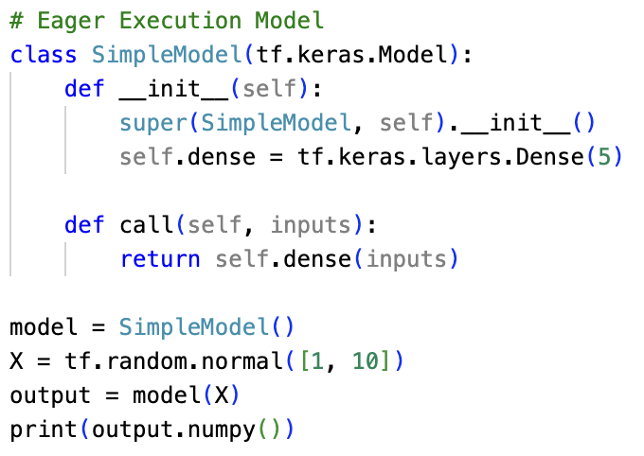
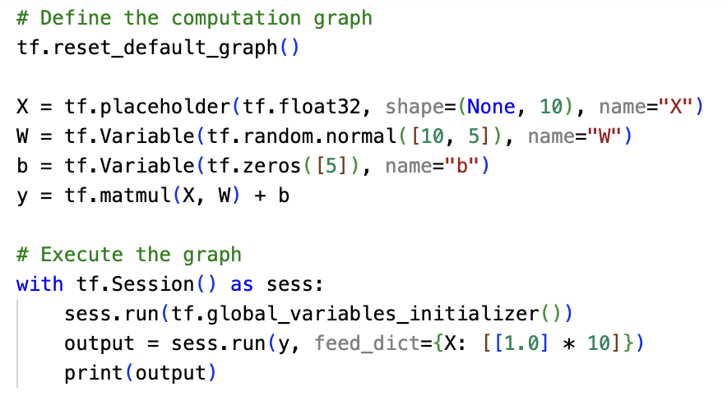
Graph Mode vs. Eager Mode
Graph Mode
Defines the entire computation graph before execution.
Compile-Time Optimizations:
Enables operator fusion, constant folding, and global optimizations
Eager Mode
Immediate Execution:
Operations execute as they are called, allowing dynamic control flow
East of Debugging
Intuitive and interactive, making it easier to trouble shoot and prototype.
Limited Global Optimizations:
Fewer opportunities for compile-time performance enhancements.
Eager Execution (Tensorflow 2.x)
Graph Execution (Tensorflow 1.x)
Notes:
Graph mode defines the computation graph before execution, enabling optimizations like constant folding and operator fusion.
Compile-time optimizations in graph mode reduce runtime overhead by precomputing static operations.
Eager mode executes operations dynamically, making it intuitive for debugging but less optimized for large workloads.
Graph mode is better suited for performance-critical AI applications, while eager mode is useful for prototyping and experimentation.

Slide 7
Dynamic Graph Compilation on CPUs
Definition:
The process of transforming a dynamic (runtime-evolving) computation graph into optimized machine code on the fly.
Key Mechanisms:
Just-In-Time (JIT) Compilation: Compile portions of the graph during execution.
Operator Fusion & Inlining: Merges multiple operations to reduce overhead. (e.g. torch.jit.trace(func))
Benefits:
Adaptability: Adjusts to changing input shapes and model behaviour (e.g. nn.AdaptiveMaxPool2d)
Improved Performance: Generates code optimized for current workload, reducing latency
Flexibility: Supports dynamic model structures without a complete recompilation.
Feature | JIT Compilation | Static Compilation
Execution | Dynamic (on-the-fly) | Predefined (ahead of time)
Performance | Optimized at runtime | Optimized before execution
Adaptability | Adjusts to workload | Fixed, less flexible
Overhead | Slight Overhead | High compilation time
Notes:
Dynamic graph compilation transforms evolving computation graphs into optimized machine code on the fly.
Just-in-time (JIT) compilation allows portions of the graph to be compiled during execution, improving flexibility.
Operator fusion and inlining merge multiple operations, reducing computational overhead.
Benefits include improved adaptability to changing workloads, optimized performance, and reduced latency without requiring full recompilation.

Slide 8
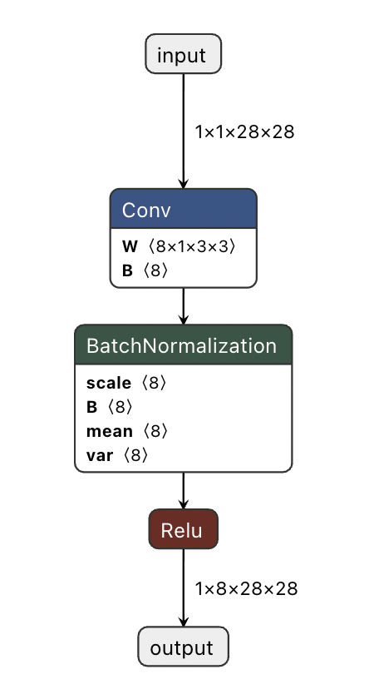
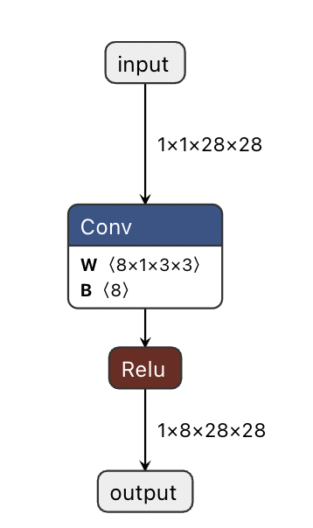
Static Graph Compilation
Definition:
The entire computation graph is defined, optimized and compiled ahead of execution.
The structure remains fixed throughout runtime.
Key Mechanisms:
Operator fusion, constant folding, and memory layout adjustments are performed at compile time.
Global Analysis: Enables comprehensive optimization across the entire graph, considering all dependencies
Benefits:
Enhanced Performance:
Global optimizations yield highly efficient runtime execution
Predictability:
Deterministic execution flow ideal for production environments.
Optimized Hardware Utilization:
Pre-compiled kernels can better exploit specialized CPU features.
Identical Operations, different graphs. Left graph, BatchNorm operation is separate operator. In right graph, BatchNorm has been fused into the preceding convolution layer.
Notes:
Defines the entire computation graph ahead of execution, ensuring efficient and predictable runtime performance.
Operator fusion, constant folding, and memory layout adjustments are applied at compile time to reduce runtime overhead.
A full-graph global analysis enables comprehensive optimizations across dependencies.
Benefits include enhanced performance due to precomputed optimizations, deterministic execution flow, and better hardware utilization.
Precompiled kernels can maximize CPU efficiency by leveraging specialized processor features.

Slide 9


Static vs. Dynamic Compilation – A Comparison
Static Compilation:
Graph fixed and compiled ahead-of-time
Global optimizations yield deterministic performance
Ideal for stable, production workloads.
Advantages:
More predictable performance (fewer surprises at runtime).
Often faster execution for stable workloads.
However, less flexibility if input shapes or control flow vary widely.
Examples
Some deep learning frameworks when using ahead-of-time graph compilation (e.g., XLA, TVM, some ONNX runtime scenarios, Llama.cpp).
Dynamic Compilation:
On-the-fly JIT optimizations during runtime
Adapts to changing inputs and control flow
Offers flexibility with potential runtime overhead.
Advantages:
Adapts to different runtime conditions.
Easier prototyping and debugging because you can quickly change code.
Might introduce overhead (warm-up time or re-compilation).
Examples
PyTorch’s eager mode, TensorFlow’s eager execution, or TorchScript JIT falls somewhere in between static and dynamic.
Notes:
Static Compilation
Graph is compiled ahead-of-time, leading to predictable and optimized performance.
Best suited for production workloads that require stability and efficiency.
Advantages include faster execution for fixed workloads but with less flexibility for varying input shapes or dynamic control flow.
Examples: XLA, TVM, and ONNX runtime with ahead-of-time compilation.
Dynamic Compilation
Uses Just-in-Time (JIT) optimizations that allow on-the-fly graph adaptation during execution.
Provides flexibility to adjust to changing inputs and control flow but may introduce additional runtime overhead.
Easier for debugging and prototyping but requires warm-up time before optimizations take full effect.
Examples: PyTorch eager mode, TensorFlow eager execution, and TorchScript JIT.

Slide 10
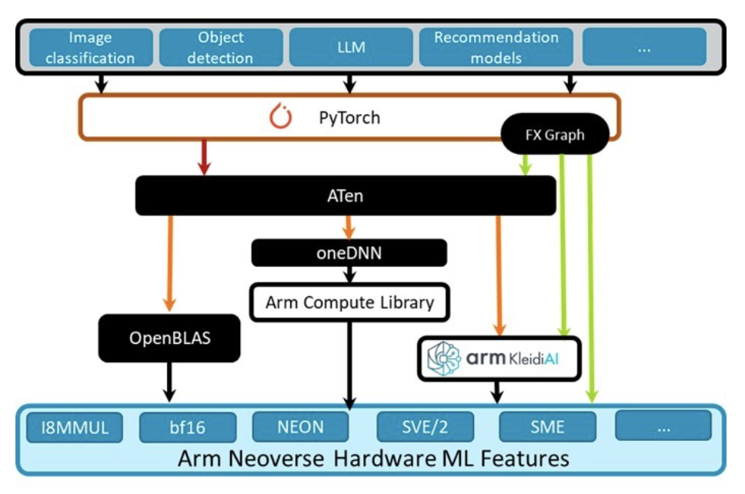
Overview of ML Frameworks on Arm
Supported Frameworks:
Pytorch: Optimized for adaptability, training, developer experience and fast prototyping
LiteRT: Optimized for mobile/embedded inference.
ExecuTorch: Optimized for mobile/embedded inference.
ONNX Runtime: Versatile cross-platform inference engine.
Arm Compute Library: Provides optimized low-level compute routines for static graph inference.
Llama.cpp: Minimalistic pure C++ project for LLM inference.
…
Hardware-Specific Optimizations
Leverages Arm’s NEON Scalable Vector and Matrix Extension (SVE/SME) instructions for efficient computation. Through low level libraries.
Custom kernel libraries tuned for Arm architectures (KleidiAI)
An example of an AI stack from high level applications to low-level implementations and Arm specific hardware features.
Notes:
PyTorch, LiteRT, and ExecuTorch are optimized for adaptability, training, and mobile inference.
ONNX Runtime provides cross-platform inference, and the Arm Compute Library offers low-level optimized routines.
Llama.cpp is a lightweight C++ inference framework suitable for LLMs on CPUs.
Arm-specific optimizations leverage NEON and SVE instructions for high-efficiency computation.
Custom kernel libraries like KleidiAI further optimize ML workloads on Arm-based architectures.

Slide 11
PyTorch on Arm
User-Level API:
Python functions (e.g., torch.add()) initiate tensor operations
Central Dispatcher:
Routes calls based on tensor type, device and data type
Determines correct implementation
Aten – The Tensor Library:
Acts as the bridge between the dispatcher and low-level kernels.
Provides a unified API for tensor operations
Backend Libraries & Optimizations:
OpenBLAS
On Arm, optimized routines leverage hardware-specific instructions
KleidiAI
Arm specific operator implementations leveraging hardware features including (NEON/I8MM/SVE/SVE2/SME/..)
Extensibility:
Supports custom backends and operator registrations, enabling further hardware-specific tuning.
The Pytorch Stack and it’s dispatching logic.
Notes:
PyTorch functions route through the central dispatcher, which determines the appropriate low-level implementation.
The ATen tensor library serves as the bridge between high-level operations and hardware-optimized kernels.
Backend optimizations include OpenBLAS for efficient linear algebra routines and KleidiAI for Arm-specific acceleration.
Extensibility features allow custom backend registrations to enhance hardware-specific optimizations.

Slide 12
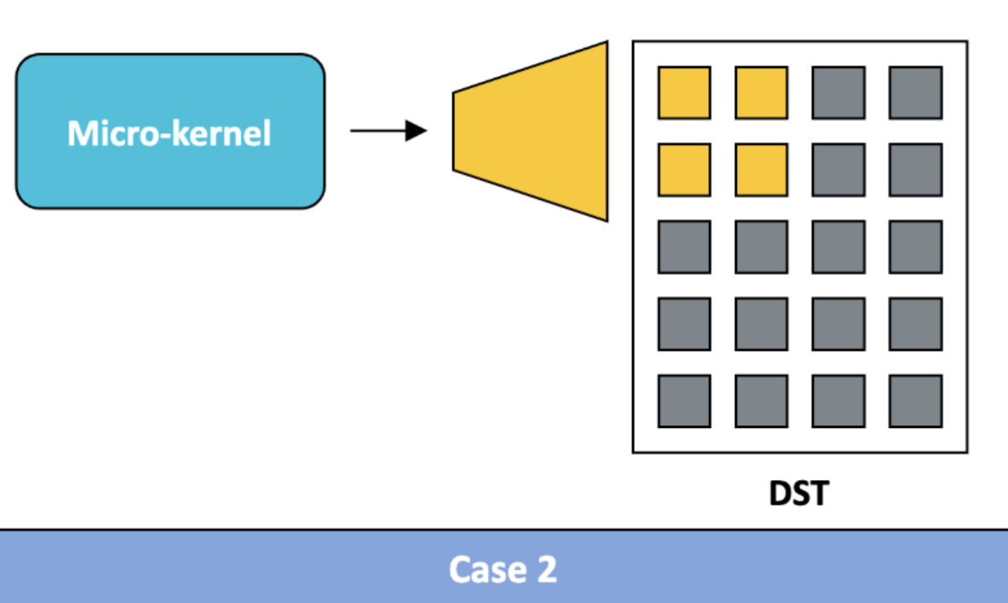
Optimised Libraries – KleidiAI
What Are Micro-Kernels?
Highly optimized low-level compute functions designed to accelerate matrix multiplications and tensor operations.
Used in Arm CPU inference engines to maximize performance for ML workloads.
Why Do Micro-Kernels Matter for Inference?
Cache-Aware Execution: Optimized to fit within CPU cache, reducing memory bandwidth usage
Leverages specialized instructions (e.g., I8MM, SVE, SVE2, SME, DotProd) to process multiple data points in parallel.
Custom implementations for critical operations like GEMM (General Matrix Multiplication) and convolutions.
Designed to operate on only part of the input, so they can be scaled efficiently across multiple CPU cores.
Enables efficient computation with low precision formats such as INT4 and INT8, BF16.
Example of a Micro-Kernel, that produces a portion of the output, operating on only a portion of the input.
Notes:
Micro-kernels are highly optimized low-level compute functions designed for accelerating tensor operations.
These kernels optimize cache-aware execution, reducing memory bandwidth usage and improving performance.
Leverages Arm-specific instructions like SVE, DotProd, and I8MM for parallelized data processing.
Specialized implementations for GEMM (matrix multiplication) and convolution operations improve efficiency.
Supports low-precision data types such as INT4, INT8, and BFP16 to enhance compute performance on Arm CPUs.

Slide 13

Llama.cpp for Lightweight Inference
Lightweight & Efficient:
Pure C++ implementation designed for minimal memory and computation footprint of LLMs.
Optimized for CPU:
Tailored for efficient execution on consumer-grade CPUs with low-level optimizations.
Includes integration with low-level Arm optimized operators such as (KleidiAI)
Resource-Constrained Environments:
Ideal for edge deployment and devices with limited resources
Simplicity & Accessibility:
Minimal dependencies and straightforward integration.
Targeted for inference:
Streamlined for inference tasks, balancing performance with resource efficiency
Limited to a select number of LLM Architectures
Notes:
Llama.cpp is designed as a lightweight and efficient implementation for inference, using a minimal memory and compute footprint.
It is optimized for CPU execution, leveraging low-level optimizations to run efficiently on consumer-grade processors.
Ideal for resource-constrained environments, enabling deployment on edge devices with limited computational power.
Focuses on simplicity and accessibility, with minimal dependencies for easy integration into projects.
Targeted specifically for efficient inference, prioritizing performance while maintaining resource efficiency.

Slide 14
Summary
Efficient inference on CPUs:
CPUs offer cost, and energy advantages making them viable for a wide range of inference tasks despite rising model complexity.
Optimizing Through Graph Structures:
Using a directed acyclic graph (DAG) simplifies understanding and enables powerful optimizations, such as operator fusion and parallel processing.
Static vs. Dynamic Execution:
Graph mode (static compilation) delivers predictable, optimized performance, ideal for production.
Eager execution and JIT provide flexibility and rapid prototyping, adapting to dynamic inputs and control flows.
Hardware-Level Enhancements:
Leveraging specialized instructions and micro-kernels (e.g. NEON, SVE, I8MM) ensures that CPU inference can meet low-latency and high throughput demands, even in resource constrained environments.
Framework Ecosystem:
A variety of frameworks and libraries (e.g., PyTorch, Arm Compute Library, Llama.cpp) support these optimizations, catering to diverse deployment scenarios from cloud to the edge.
Notes:
Efficient inference on CPUs offers significant cost and energy benefits, making CPUs a viable choice for many AI applications.
Optimizing through graph structures simplifies understanding and debugging while enabling performance improvements through optimizations like operator fusion.
Static vs. dynamic execution trade-offs highlight how static compilation provides stability and optimization, while dynamic execution adapts to runtime conditions.
Hardware-level enhancements such as vectorized instructions like NEON, SVE, and I8MM improve CPU inference efficiency.
Framework ecosystem ensures broad compatibility, with multiple libraries like PyTorch, ONNX Runtime, and Llama.cpp supporting CPU-based inference across various deployment scenarios.

Slide 15
Questions and Discussion

